Slide 1
19CSE305: MACHINE LEARNING LINEAR REGRESSION

Slide 2
What is Linear Regression?
Learning
A supervised algorithm that learns from a set of training samples.
Each training sample has one or more input values and a single output value.
The algorithm learns the line, plane or hyper-plane that best fits the training samples.
Linear regression is a linear model, e.g. a model that assumes a linear relationship between the input variables (x) and the single output variable (y)
Prediction
Use the learned line, plane or hyper-plane to predict the output value for any input sample.

Slide 3
Regression
Regression is a method of modelling a target value based on independent predictors.
This method is mostly used for forecasting and finding out cause and effect relationship between variables.
Regression techniques mostly differ based on the number of independent variables and the type of relationship between the independent and dependent variables.
Simple Linear Regression
Multiple Linear Regression
Logistic Regression

Slide 4
Regression-Examples
Real Estate Price prediction
Dependent variable is retail price of gasoline in India – independent variable is the price of crude oil.
Dependent variable is employment income – independent variables might be hours of work, education, occupation, sex, age, region, years of experience, unionization status, etc.
Price of a product and quantity produced or sold:
Quantity sold affected by price. Dependent variable is quantity of product sold – independent variable is price.

Slide 5
Regression-Example
Housing Prices
Price
(in 1000s of dollars)
1500 sqfeet
Size (feet²)
Supervised Learning
Given the “right answer” for each example in the data.
Regression Problem
Predict real-valued output

Slide 6
Linear Regression
Statistical model that analyzes the linear relationship between a dependent variable(Y) with given set of independent variables(X).
Linear relationship: when the value of one or more independent variables will change (increase or decrease), the value of dependent variable will also change accordingly (increase or decrease).
Y can be calculated from a linear combination of the input variables (X).
Simple Linear Regression
Multiple Linear Regression
When there is a single input variable (x), the method is referred to as simple linear regression.
When there are multiple input variables, literature from statistics often refers to the method as multiple linear regression.

Slide 7
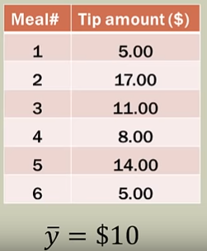
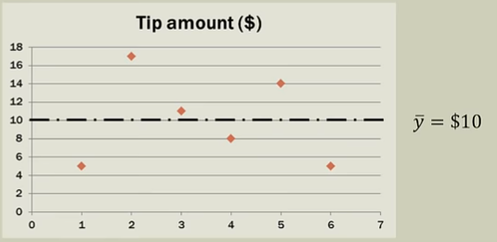
How do we predict with only one variable?
Best-fit line for this data is only based on the mean

Slide 8
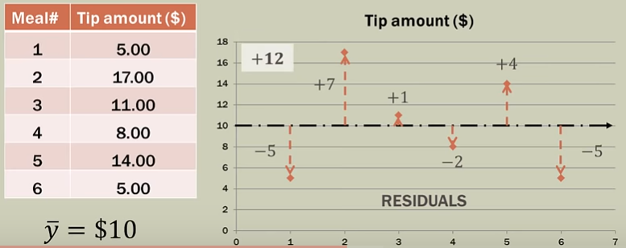
How do we predict with only one variable?
“Goodness Of Fit” is based on variability of the tip amount from the line fitted.

Slide 9
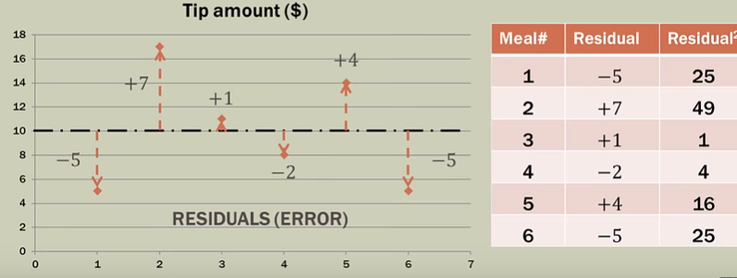
How do we predict with only one variable?
Measuring the deviation: Squared residuals or Sum of Squared Errors (SSE)

Slide 10
Simple Linear Regression
The Goal of Simple Line regression is to create a liner model that minimizes the sum of squared residuals/errors (SSE)

Slide 11
Simple Linear Regression
Independent Variable
Dependent Variable
Training set of
housing prices
(Portland, OR)
Size in feet² (x) | Price ($) in 1000's (y)
2104 | 460
1416 | 232
1534 | 315
852 | 178
… | …
Notation:
m = Number of training examples
x’s = “input” variable / features
y’s = “output” variable / “target” variable
Y=F(X)

Slide 12
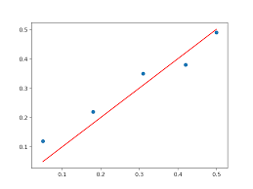
Model Representation
Training Set
How do we represent h ?
Learning Algorithm
Size of house
h
Estimated price
X
Hypothesis
Y
Linear regression with one variable.
Univariate (ONE) linear regression.

Slide 13
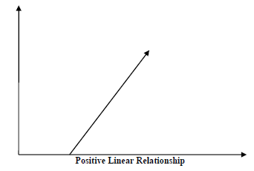
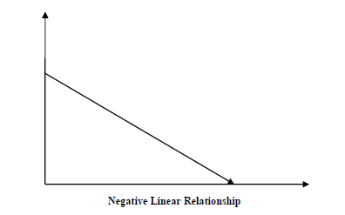
Slope of the simple linear regression model
A linear relationship will be called positive if both independent and dependent variable increases.
A linear relationship will be called positive if independent increases and dependent variable decreases.

Slide 14
Training Set
Size in feet² (x) | Price ($) in 1000's (y)
2104 | 460
1416 | 232
1534 | 315
852 | 178
… | …
Hypothesis:
‘s: Parameters
How to choose ‘s ?

Slide 15
Effect of Parameters
Inference: For different et of parameters, different regression lines can be formed.
How to elect the best fit line????

Slide 16
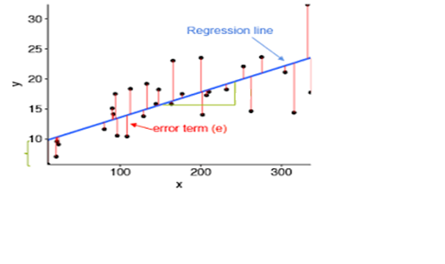
Error in Simple Linear Regression
y
P1
P0
x
Choose parameters P1,P0 so that the predicted value h(x) is close to Y for our training examples (X,Y).
The sum of the squares of the residual errors are called the Residual Sum of Squares or RSS.
The average variation of points around the fitted regression line is called the Residual Standard Error (RSE).

Slide 17
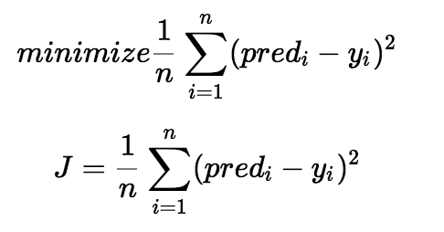
Cost Function
P1
P0
Choose parameters P1,P0 so that the predicted value h(x) is close to Y for our training examples (X,Y).
The cost function helps us to figure out the best possible values for P0 and P1 which would provide the best fit line for the data points.
minimize the error between the predicted value and the actual value.
Mean Squared Error(MSE)

Slide 18
Simple Linear Regression
P1
P0
Regression : finding the best fit line/curve to your numerical data
—a functional approximation of the data.
Analytical Solution Numerical Solution
Ordinary Least Squares (OLS) Gradient Descent

Slide 19
Analytical Solution Ordinary Least Squares (OLS)

Slide 20
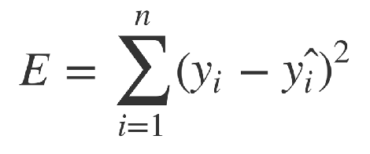
Single Dimension Least Square Linear Regression
We want a line that minimises the error between the Y values in training samples and the Y values that the line passes through.
Or put another way, we want the line that “best fits’ the training samples.
So we define the error function for our algorithm so we can minimise that error. This is called as Sum-of-Square Error (SSE)

Slide 21
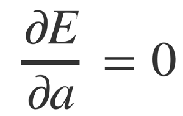
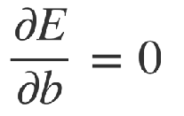
Single Dimension Least square Linear Regression
To determine the value of a that minimises the error E, we look for where the partial differential of E with respect to a and b is zero.

Slide 22
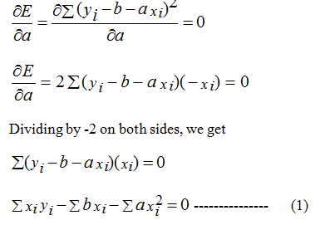
Single Dimension Least square Linear Regression

Slide 23
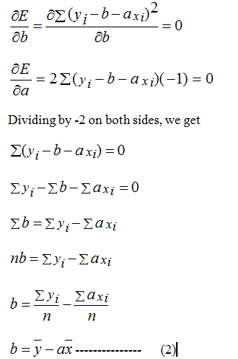
Single Dimension Least square Linear Regression

Slide 24
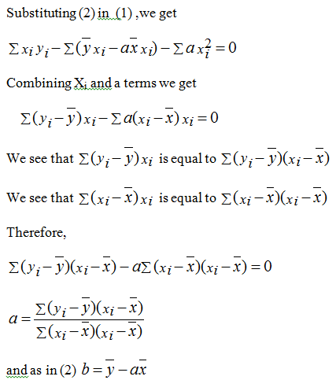
Single Dimension Least square Linear Regression

Slide 25
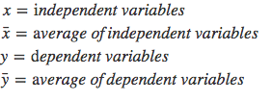
Ordinary Least Squares (OLS)

Slide 26
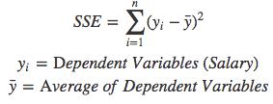
Ordinary Least Squares (OLS)
Years of Experience | Salary
2 | 15
3 | 28
5 | 42
13 | 64
8 | 50
16 | 90
11 | 58
1 | 8
9 | 54
Salary
Years of Experience

Slide 27
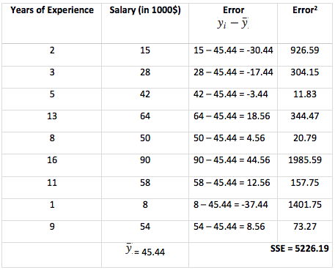
Ordinary Least Squares (OLS)

Slide 28
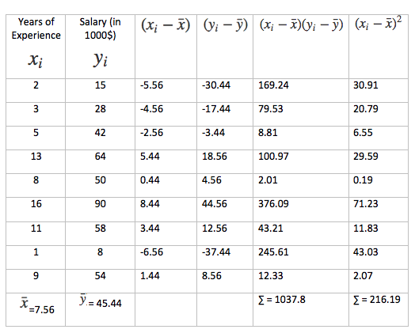
Ordinary Least Squares (OLS)

Slide 29
Ordinary Least Squares (OLS)
Years of Experience | 4.8*X+9.15
2 | 18.75
3 | 23.55
5 | 33.15
13 | 71.55
8 | 47.55
16 | 85.95
11 | 61.95
1 | 13.95
9 | 52.35

Slide 30
Ordinary Least Squares (OLS)
ALGORITHM
Step 1: Calculate the mean of X and Y.
Step 2: Calculate the errors of X and Y.
Step 3: Get the Product.
Step 4: Get the summation of products.
Step 5: Square the difference of X.
Step 6: Get the sum of squared difference.
Step 7: Divide output of step 4 by output of step 6 to calculate slope(P1).
Step 8: Calculate P0 using P1

Slide 31
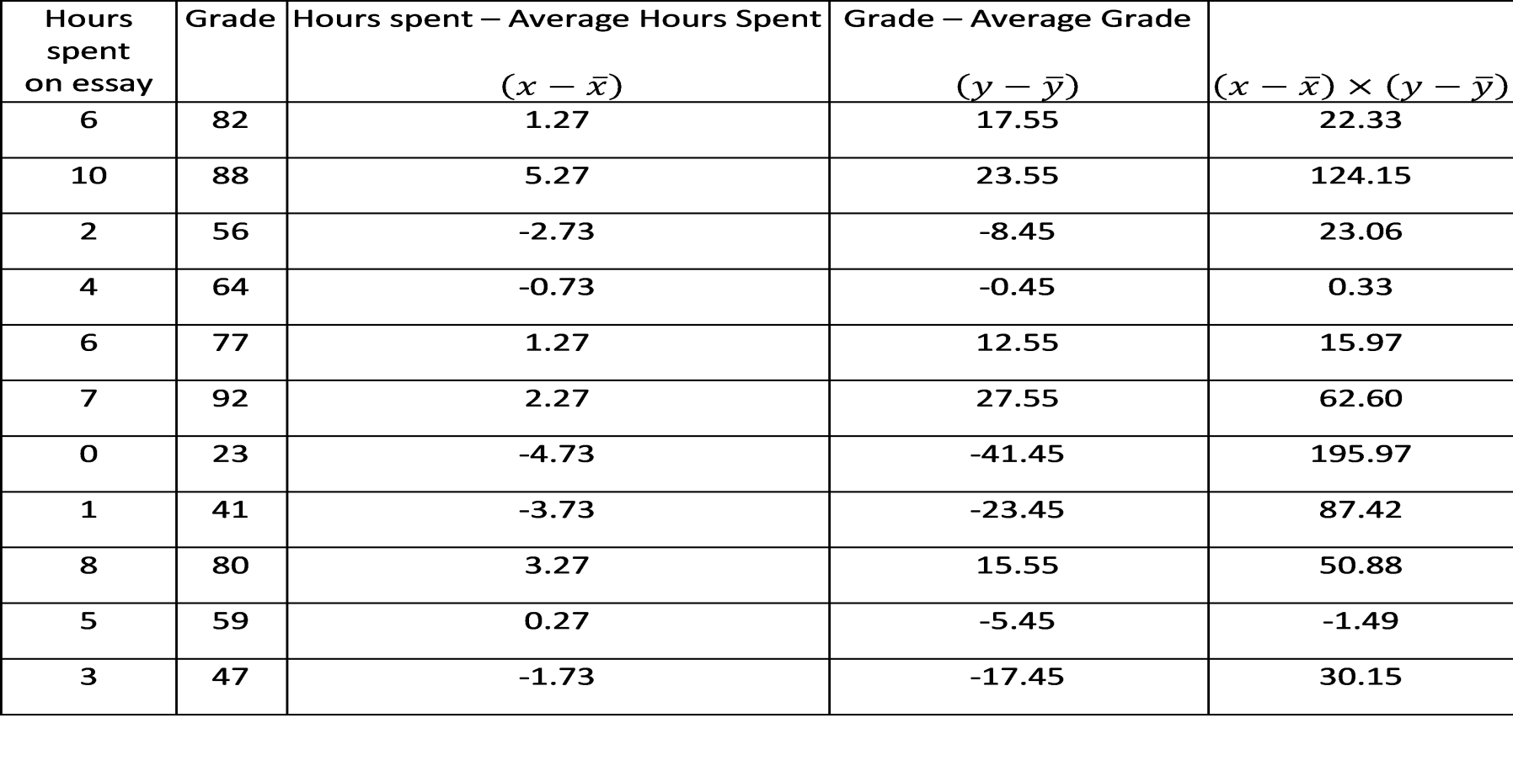
Single Dimension Least Square Linear Regression - Numerical Example

Slide 32
Single Dimension Least Square Linear Regression - Numerical Example
∑(x-x ̅ ) * (y-y ̅ ) = 611.36
∑(x-x ̅ ) ^2 = 94.18
b= 611.36 / 94.18 = 6.491
a= 64.45 – (6.491* 4.72) = 30.18
Y^ = 30.18 + 6.49x

Slide 33
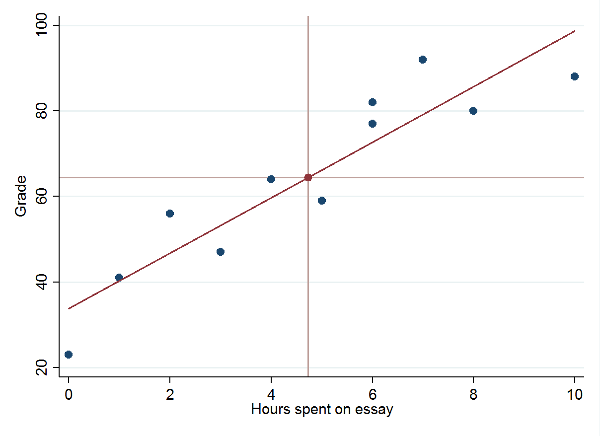
Single Dimension Least Square Linear Regression - Numerical Example

Slide 34
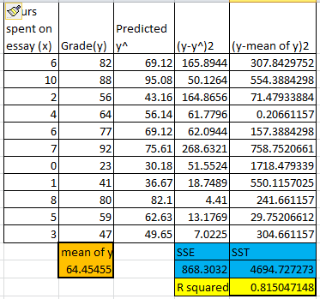
Single Dimension Least Square Linear Regression - Numerical Example

Slide 35
Single Dimension Least Square Linear Regression - Numerical Example
******As some of you will have noticed, a model such as this has its limitations. For example, if a student had spent 20 hours on an essay, their predicted score would be 160, which doesn’t really make sense on a typical 0-100 scale. It’s always important to understand the realistic real-world limitations of a model and ensure that it’s not being used to answer questions that it’s not suited for.

Slide 36
Ordinary Least Squares (OLS)
Sample Question
Internal Exam | External Exam
15 | 49
23 | 63
18 | 58
23 | 60
24 | 58
22 | 61
22 | 60
19 | 63
19 | 60
16 | 52
24 | 62
11 | 30
24 | 59
16 | 49
23 | 68

Slide 37
Ordinary Least Squares (OLS)
x | y
1 | 2
2 | 1
3 | 3
4 | 6
5 | 9
6 | 11
7 | 13
8 | 15
9 | 17
10 | 20

Slide 38
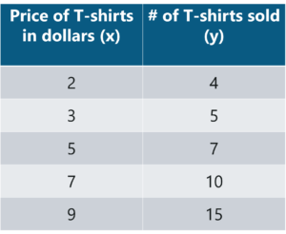
Ordinary Least Squares (OLS)
Sample Question
x (year) | 2005 | 2006 | 2007 | 2008 | 2009
y (sales) | 12 | 19 | 29 | 37 | 45
a) Find the least square regression line y = a x + b. b) Use the least squares regression line as a model to estimate the sales of the company in 2012.

Slide 39
Numerical Solution Gradient Descent

Slide 40
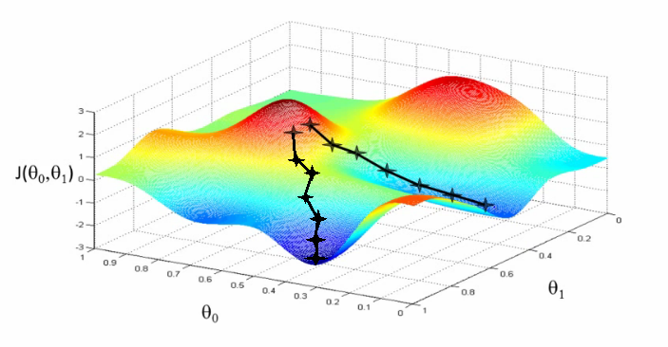
Why Gradient Descent??
Ordinary Least Square method looks simple and computation is easy.
OLS algorithm is subtle for multivariate datasets: with multiple dependent variables
Gradient descent algorithm’s main objective is to minimize the cost function.
It is one of the best optimization algorithms to minimize errors (difference of actual value and predicted value).
In a real world example, it is similar to find out a best direction to take a step downhill.
Gradient Descent 3D diagram. Source: Coursera — Andrew Ng

Slide 41
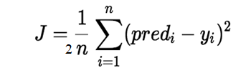
Cost Function
P1
P0
Choose parameters P1,P0 so that the predicted value h(x) is close to Y for our training examples (X,Y).
The cost function helps us to figure out the best possible values for P0 and P1 which would provide the best fit line for the data points.
1/2 is a constant that helps cancel 2 in derivative of the function when doing calculations for gradient descent
minimize the error between the predicted value and the actual value.
Mean Squared Error(MSE)

Slide 42
Hypothesis VS Cost Function
Hypothesis:
Assume: P0=0
Parameters:
Cost Function:
Goal:

Slide 43
(for fixed , this is a function of x)
(function of the parameter )
y
x

Slide 44
Hypothesis VS Cost Function
Hypothesis h(x) | Cost Function J(P1)
For a fixed value of P0, function of x | Function of parameter
Each value of corresponds to a different hypothesis as it is the slope of the line | For any such value of , J(P1) can be calculated by setting P0=0
It is a linear line or a hyperplane | Squared error cost function is convex in nature

Slide 45

(for fixed , this is a function of x)
(function of the parameter )
y
x

Slide 46
(for fixed , this is a function of x)
(function of the parameter )
y
x

Slide 47
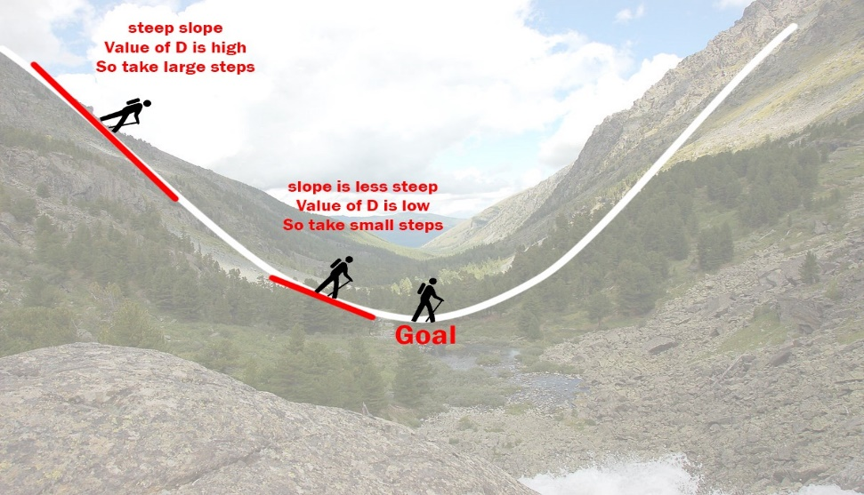
The Gradient Descent Algorithm
Gradient descent is an iterative optimization algorithm to find the minimum of a function.
Here that function is the Loss Function.
Take large steps when the slope is steep and small steps when the slope is less steep.
Next position based on the current position and stops when gets to the bottom of the valley which was his goal.

Slide 48
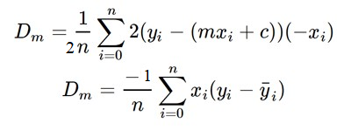
The Gradient Descent Algorithm
Let P0=c P1=m
Step 1:
Initially let m = 0 and c = 0. Let L be learning rate. This controls how much the value of m changes with each step. L could be a small value like 0.0001 for good accuracy.
Step 2:
Calculate the partial derivative of the loss function with respect to m, and plug in the current values of x, y, m and c in it to obtain the derivative value D.

Slide 49
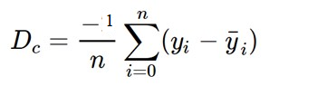
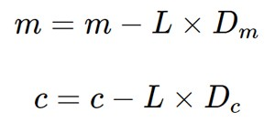
The Gradient Descent Algorithm
Let P0=c P1=m
Step 3:
Dₘ is the value of the partial derivative with respect to m. Similarly lets find the partial derivative with respect to c, Dc
Step 4:
Now we update the current value of m and c using the following equation:
Step 5:
Repeat this process until the loss function is a very small value or ideally 0 (which means 0 error or 100% accuracy). The value of m and c that we are left with now will be the optimum values.

Slide 50
m can be considered the current position of the person.
D is equivalent to the steepness of the slope
L can be the speed with which he moves.
New value of m that we calculate using the above equation will be his next position
L×D will be the size of the steps he will take.
When the slope is more steep (D is more) he takes longer steps and when it is less steep (D is less), he takes smaller steps.
Finally he arrives at the bottom of the valley which corresponds to our loss = 0.

Slide 51
THANK YOU

